Slide 1
Deliverables
1. Business Proposal Report in .pptx format. The following needs to be covered:
• Clear visual analysis, graphs & charts to show understanding on dataset / features
• Model & Methodology of Machine Learning Model used
• Accuracy measure of ML model and justification of metric selection
• Solution proposals on how business should employ the ML model and insights in an operational context
• Any assumptions used for formulation
• Please keep the report to a maximum of 30 slides. Any slides above that will not be assessed.
2. Python Notebook in .ipynb format
• All graphs, charts, model and accuracy score needs to be shown in the submitted Juypter notebook
• Comments and Insights in the notebook will NOT be taken into account and these should be incorporated in the PowerPoint rep

Slide 2
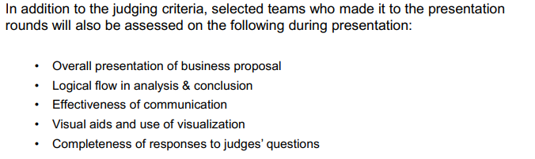
Additional Areas of Assessment during Presentation

Slide 3
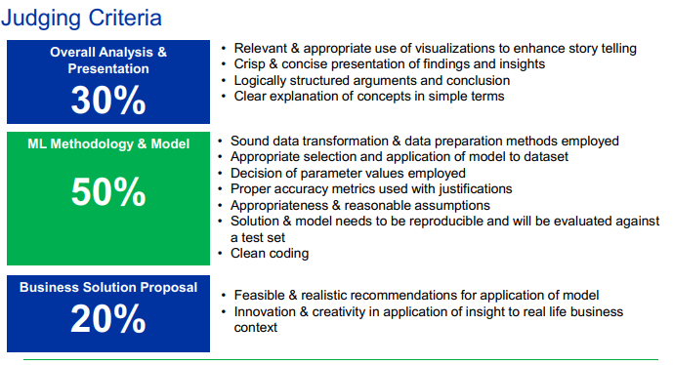
Judging Criteria

Slide 4
Company: 25Credit
Company: Global Credit Card Company
Issues:
-Annual $10 million fraudulent transactions
-Significant costs and effort in the investigation and management of these transactions (lag time from occurrence of the fraud to the reporting)
-Hard to recover the full amount from transactions due to time lapse
Objective:
-find solutions to reduce time and effort for investigation
- improve on the fraud recover through early identification and proactive management of suspicious transactions

Slide 5
-Analysis & Understanding of the Current Problem and Data
-Technical ML model
-Recommendations on Integrating the insights into action plans / solutions to tackle 25Credit’s business challenges

Slide 6
Naive Bae-s

Slide 7
Exploratory Data Analysis (5 Slides)

Slide 8
Data Preprocessing (5 Slides)
Missing Value Pattern Analysis and Multiple Imputation
Outlier Analysis
Feature Re-engineering
Feature Selection
Data Resampling

Slide 9
Classification Model Selection (7 Slides)
Proposed Models
Parameter Selection
Assumptions
Evaluation Metrics

Slide 10
Model Comparison (3 Slides)
Comparison on different models based on evaluation metrics
Final Model Selection
Limitation of Models and Mitigations

Slide 11
Recommendation (8 Slides)
Soulution 1
Solution 2
Solution 3

Slide 12
Conclustion (1 Slide)

Slide 13


25Credit
9872 4908 2345 9898
1234
VALID TILL 12/19
Team: NAÏVE BAE-S

Slide 14
Introduction
Classification Model Building
Model
Selection
Model
Comparison
Business
Solution
Introduction

Slide 15
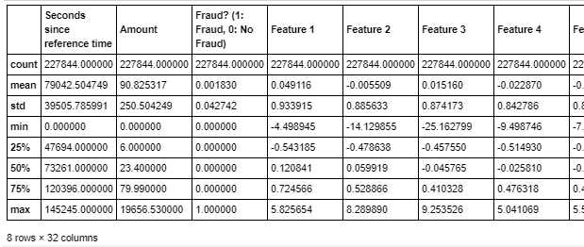
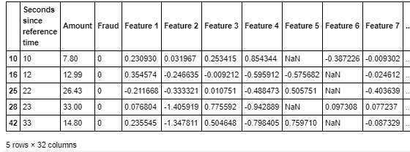

Exploratory Data Analysis
Summary Statistics
- Features columns are generally similar in values range (due to PCA transformation)
- Seconds since Reference Time & Amount have different scale.
Missing Values
- Presence of Missing Values
Duplicated Values
- No duplicated Values

Slide 16
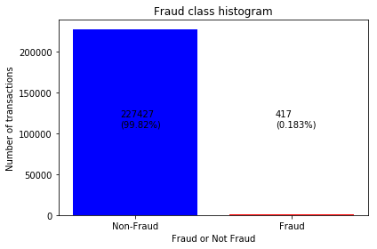
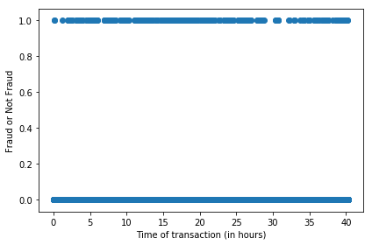
EDA
Fraud Class Analysis
Fraud Class Histogram
Scatter Plot of Fraud Class & Transaction Time
- indication of significant unbalance between data points for class “Fraud” and “Non-Fraud”
-Pattern for both non-fraudulent and fraudulent transactions seems to be random regardless of hour of the day
Need to conduct resampling
“Seconds Since Reference Time” not a good predictor
Notes:
Fraud Class Analysis
Fraud Class Histogram
Scatter Plot of Fraud Class versus Seconds since Reference Time
Scatter Plot of Fraud Class versus Transaction Amount
Line Graph of Density of Probability for Fraud Class versus Transaction Amount

Slide 17
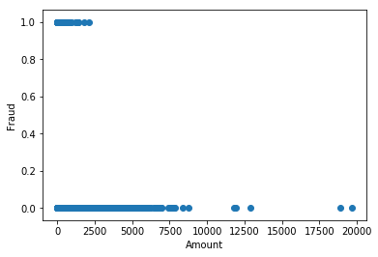
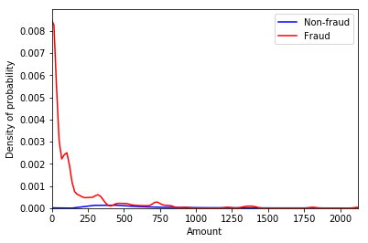
EDA
Fraud Class Analysis
EDA
Scatter Plot of Fraud Class & Transaction Amount
Line Graph of Density of Probability for Fraud
Fraudulent transactions more concentrated towards lower amount (<2500)
Density of probability for fraud is much higher for lower amount & it increases as the amount lowers

Slide 18







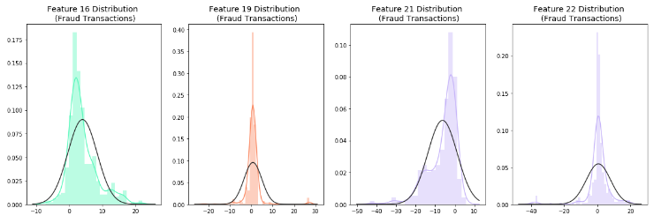
EDA
Anomaly/Outlier Detection
EDA
EDA
Feature 16
Feature 19
Feature 21
Feature 22
Rational for Not Removing Outliers
Outliers are value adding for fraud detection classification model
Notes:
Since Feature 16, 19, 21 and 22 has much higher range (between 76 to 95) as compared to the rest, we will check for the distribution plot of these features.
Even though the features contains outliers, these outlier values adds value to the fraud detection classification model

Slide 19
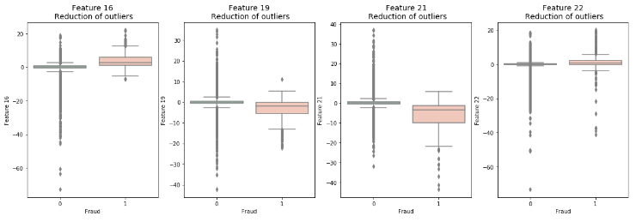
EDA
Anomaly/Outlier Detection
EDA
EDA
Feature 16
Feature 19
Feature 21
Feature 22
Rational for Not Removing Outliers
Outliers values are present in both “Fraud” and “Non-Fraud” class labels

Slide 20
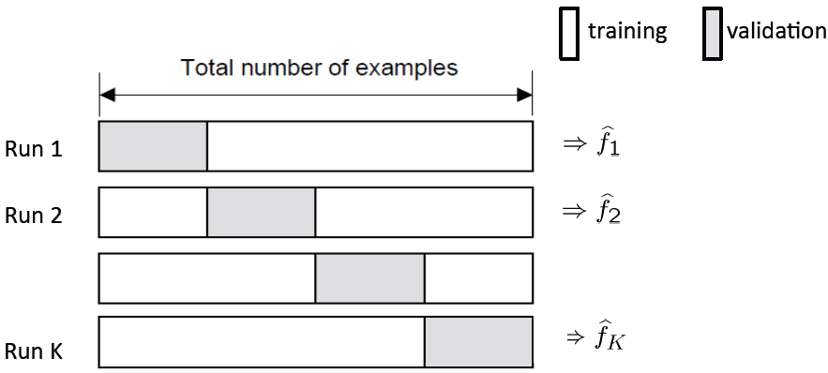
Splitting of Dataset
Train Set
Test Set
70%
30%
K-fold Cross-Validation
Test Set: to be used for model evaluation metrics
Training Set: used for model training while k-fold cross validation is used for parameter tuning
Notes:
Source: https://towardsdatascience.com/train-validation-and-test-sets-72cb40cba9e7

Slide 21
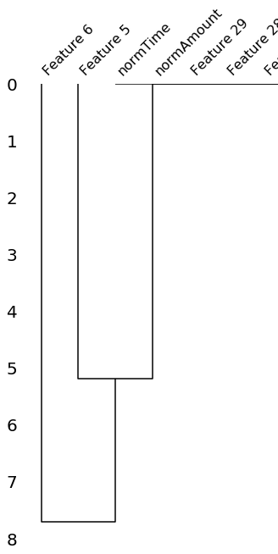
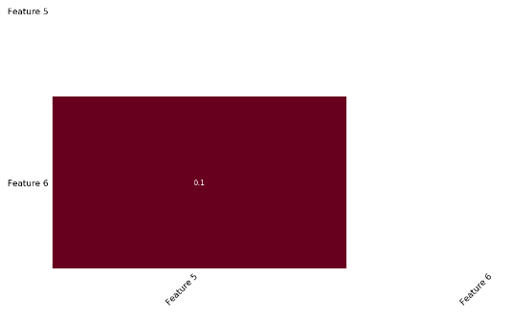
Data Cleaning – Missing Values
NULLITY CORRELATION MATRIX HEATMAP + DENDROGRAM
F5
F6
F5
F6
Marginal Correlation (0.1) bet the presence of absence of F5 & that for F6
THIS PART CANNOT UNDERSAND YET
Notes:
The missingno correlation heatmap measures nullity correlation: how strongly the presence or absence of one variable affects the presence of another. In this case, it shows that only Feature 6 and 5 are missing and there is a 0.1 correlation between the missing values in these two columns.
Dendrogram interpretation:

Slide 22



Data Cleaning – Missing Values
CHECK FOR PRESENCE OF MISSING VALUES
Feature 5
Feature 6
Only Feature 5 and 6 has missing values while the percentage of missing values over whole dataset is below 3%
Data NOT Missing Completely at Random (MCAR)
Hard to distinguish bet Missing at Random (MAR) and Missing Not at Random (MNAR)
Features definition and contexts are unknown
SOLUTION : MULTIPLE IMPUTATION (using sklearn by mean values)
Notes:
Dropping the rows will make the model biased and we will be using Imputation instead

Slide 23
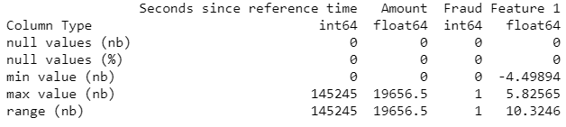
Data Transformation - Normalization
CHECK FOR ATTRIBUTE VALUES RANGE
Seconds Since Reference Time
Rational for Normalization
Time Sequence
Wide Range
adds additional weight on the features for prediction model building
Amount
Wide Range
Notes:
Since the value of amount and time have a very different scale from the rest, we should consider normalising the columns "Amount" and "Seconds since reference time"

Slide 24

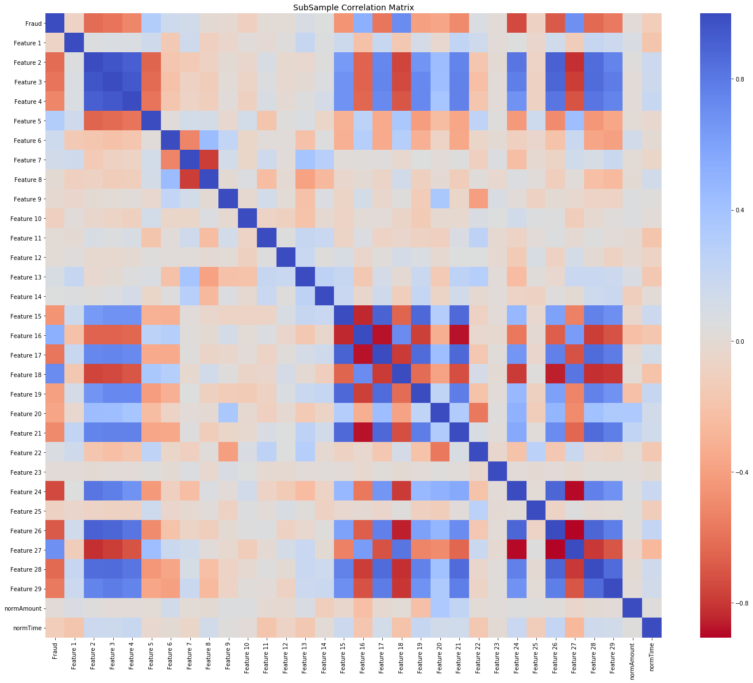
Feature Selection
Data Shuffling
Correlation Matrix
Random Forest
Step Forward Feature Selection
Parameters
No of Trees: 1000 K_features: 17
Scoring: Accuracy
Parameters
Normal Distribution
Frac: 1
Random_state: 42
Remove Features with high positive or negative correlation
[Features 7, 16, 27, 2, 21]
Selected Feature:
0, 1, 2, 4, 6, 8, 9, 10, 11, 14, 15, 17, 18, 19, 20, 21, 23
Minimize bias and patterns in the training dataset
Notes:
Data Shuffling: avoid element of bias / patterns in the split datasets (after splitting into training, testing and validation datasets) before training the ML model and subsampling → Improve ML model quality + Improve predictive performance
Correlation Metrics:
Negative Correlations: Features (7 and 8), (15 and 16), (16 and 17), (16 and 21), (24 and 27), (26 and 27) are negatively correlated.
Positive Correlations:Features (2,3, and 4), (2 and 26), (15 and 21) are positively correlated. Notice how the higher these values are, the more likely the end result will be a fraud transaction.
So now we will be removing features 7, 16, 27, 2, 21

Slide 25
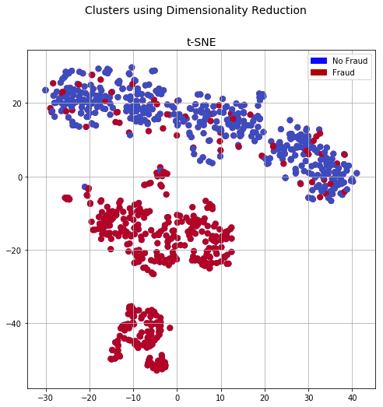
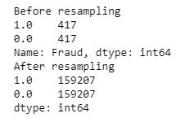
Data Resampling
T-distributed Stochastic Neighbour Embedding
Synthetic Minority Over-sampling Technique
Nonlinear Dimensionality Reduction Technique for Visualization of Clusters
Higher Performance than Conventional Oversampling and Undersampling
Parameters
Sampling Strategy = 0.5
Kind = regular
Parameters
N_components = 2
Random_state = 42
Notes:
t-SNE tells us if our prediction model will correctly able to cluster our training set datapoints correctly. From the plot above, we can see that the data can be classified into fraud and non-fraud and thus, we will be moving forward with it
SMOTE: it creates synthetic (not duplicate/replicate) samples of the minority class. Hence making the minority class equal to the majority class. SMOTE does this by selecting similar records and altering that record one column at a time by a random amount within the difference to the neighbouring records.

Slide 26
Data Transformation
SVM
Logistic Regression
Classification Model
Decision
Tree
Random Forest
Notes:
SVM: not suitable for large datasets because of its high training time

Slide 27

Evaluation Metric
Precision
Recall
F1-Score
Support
Confusion Matrix Accuracy
F Score
Notes:
Should we include formula here? And what did we choose at the end?
What evaluation metric we have chosen to evaluate our model and is it the most appropriate for the type of dataset?
Accuracy
Can’t be trusted with imbalanced dataset. Hence, used very specifically for the dataset with equal number of records for fraud and non-fraud
Confusion Matrix - precision, recall, F-score
F-score is calculated to balance the number of frauds detected and minimise the number of frauds falsely detected
AUC
We will use AUC (Area Under Curve) as the evaluation metric for parameter tunings for our Random Forest model. Our target value is binary so it’s a binary classification problem. AUC is a good way for evaluation for this type of problems

Slide 28
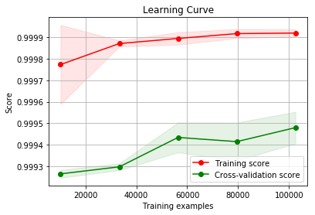
Evaluation Metric

Slide 29
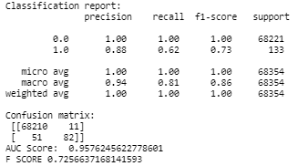
Logistic Regression
Notes:
Logistic Regression Answers

Slide 30
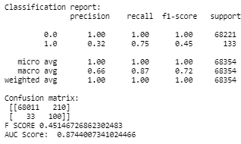
Classification Decision Tree

Slide 31
Bagging – Random Forest

Slide 32
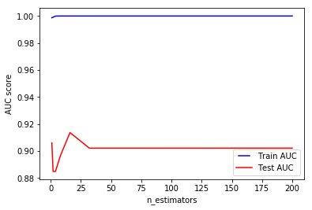
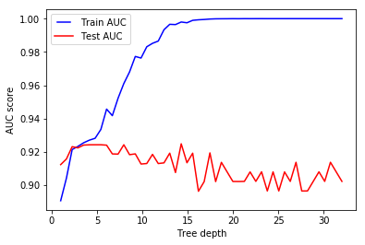
Parameter Consideration
N_estimator: 23
Reasons: Chose point when Test AUC starts to decrease over time
Max Depth: 3
Reasons: Chose point when Test AUC starts to decrease over time

Slide 33
Business Solution

Slide 34
Limitations and Constraints

Slide 35
Future Improvements
Model Stacking
Try Other Resampling Method

